Slide 1
How to create perfect website

Slide 2
Front-end

Slide 3
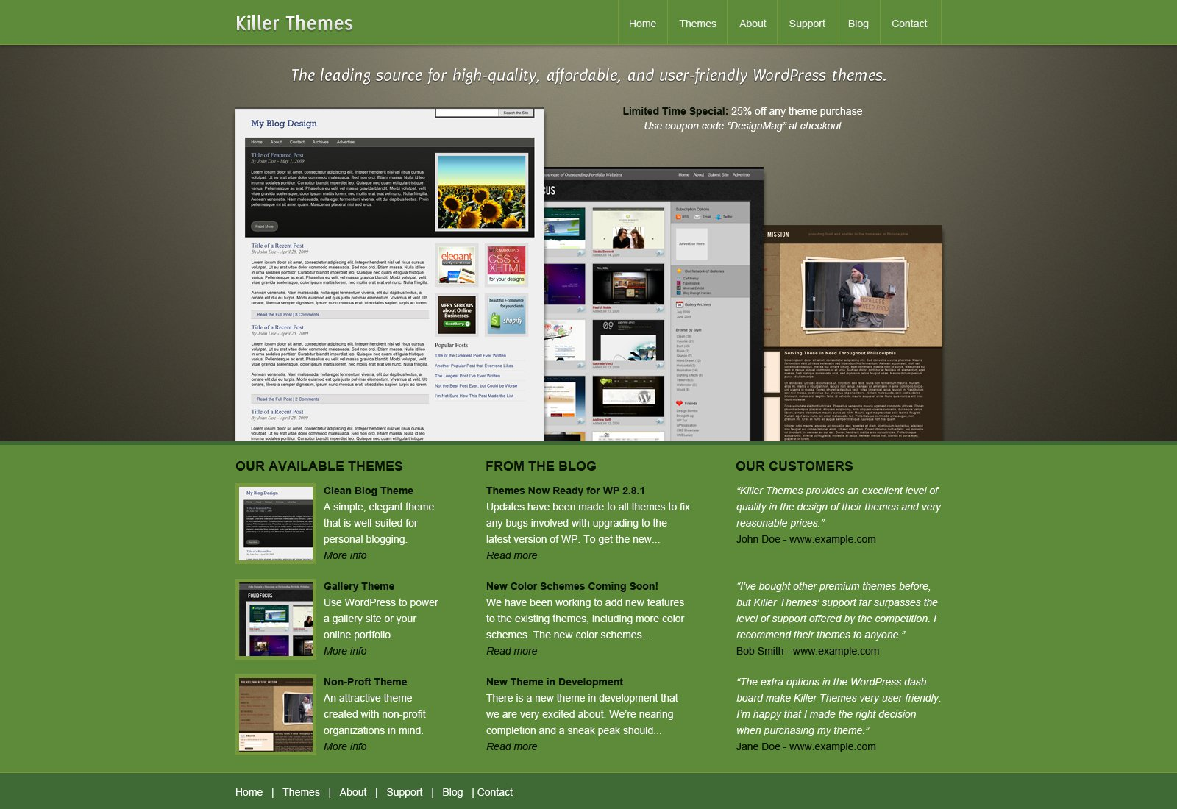
1. Layout in Photoshop

Slide 4

2. Nesting(use framework Bootstrap)

Slide 5

2.1. Using SASS or LESS

Slide 6
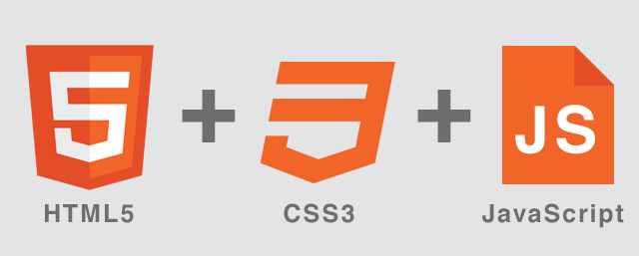

2.2 HTML5, CSS, Javascript, JQuery, Angular.js

Slide 7
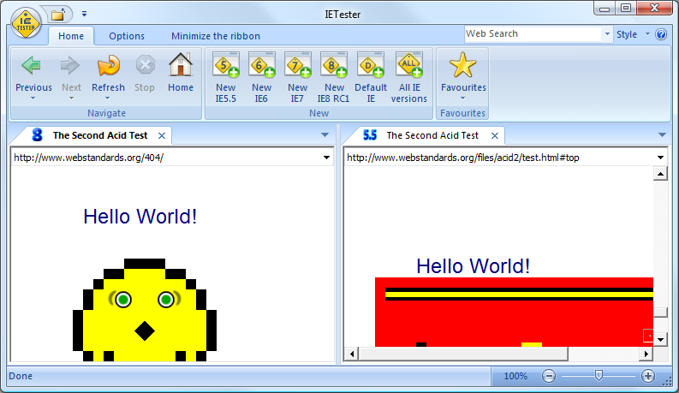
3. Testing (IEtester)

Slide 8
Back-end

Slide 9


1. Server & DB - Apache, Mysql

Slide 10

2. PHP

Slide 11

3. Framework YII

Slide 12

4. Coding

